Slide 1
Amazon Product Sales Data Analysis using Python
NAME: TEJASWINI PUSALA
ID: AF04957536

Slide 2
Overview of Dataset
The program analyzes a dataset contains of amazon product sales which includes product details, ratings, prices, discounts, and categories.
This is useful for analyzing product performance and trends by using data analysis and visualization techniques.
The data is loaded using Pandas from CSV file.
Initial inspection with .info() and .head().
Also, checked for any missing values and data types.
Loading and Inspecting Data

Slide 3
Extracting Key Columns
Only selected important columns, such as Ratings, Discounts, Reviews, Categories.
This allows focusing on sales insights and trends.
Calculating Statistics
Average ratings per category: Helps to understand the average ratings which is given by the customers on different categories
Average discounts per category: Helps to understand easily the average discounts on different categories
Total reviews across categories: The reviews given by the customers helps everyone to know about how were the quality of the products

Slide 4
Visualizing Data
Histogram chart shows about distribution of ratings by number of products
Bar charts shows product categories by number of products and average discount % for categories of top 10.
Scatter plot shows about discount % versus product rating.
The program can extract subsets of data, for example, Products with high discounts
This helps to focus on Best seller vs non-best seller
Filtering Specific Data

Slide 5
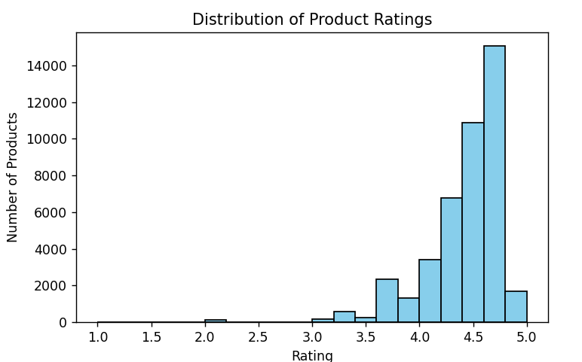
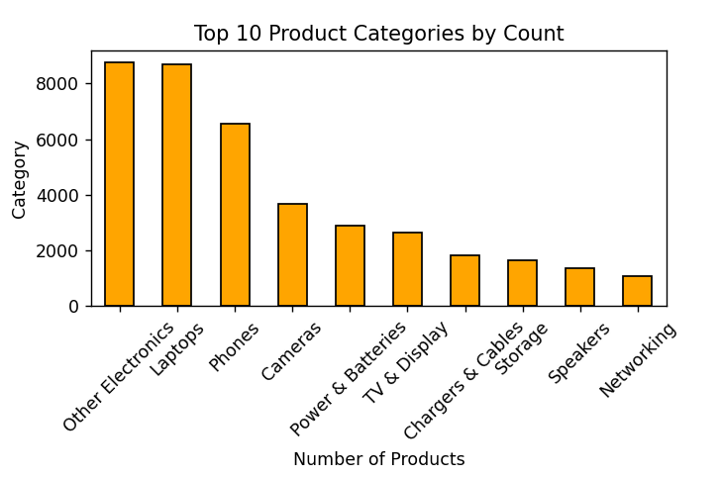
This graph shows distribution of production ratings
This graph shows product categories by number of product

Slide 6
Using Pivot Tables
Average rating per category: Summarize which product has highest ratings among different categories.
Total reviews per category: Counts the total reviews of the products on each category.
The summarized data from pivot tables is displayed as bar charts as outputs.
This provides a clear and easy vision of category-wise comparison.
VISUALIZING PIVOT TABLE RESULTS

Slide 7
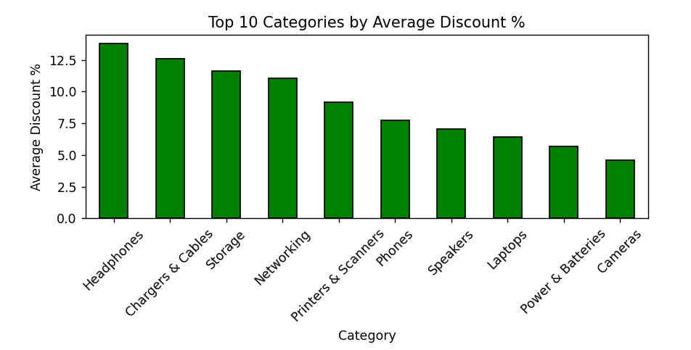
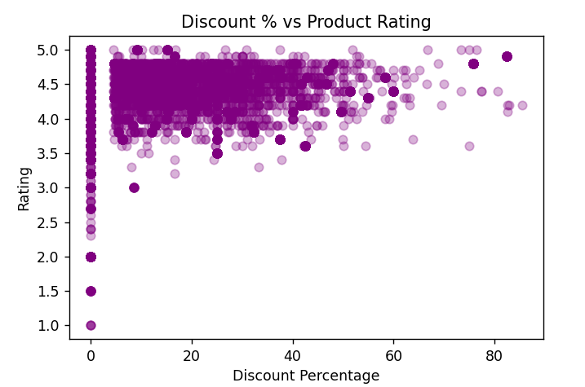
This graph shows the top 10 categories by average discount %
This graph shows discount % versus product rating

Slide 8
Conclusion
This analysis helps to understand about ratings, reviews and discounts vary widely across categories.
Visualizations like histogram, bar chart, scatter plot make patterns easy to understand.
Also, pivot tables helped to summarize key insights, such as discounts, ratings on different products .
Overall, This visualizations makes it easier to understand trends of the amazon product sales.

Slide 9
THANK YOU

